Slide 1
Migrations in Ruby on Rails
Andrii Palchik
December 2021

Slide 2

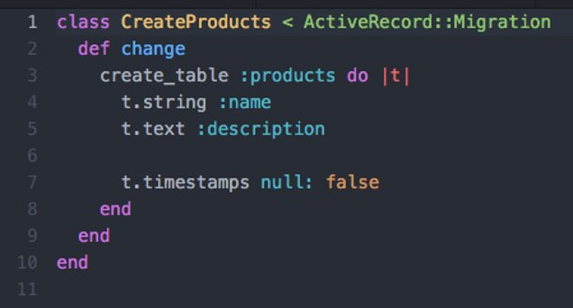

Database migrations in Ruby on Rails
Migrations are classes:​
In software engineering, schema migration (also database migration, database change ​
management) refers to the management of incremental, reversible changes to ​
relational database schemas. A schema migration is performed on a database ​
whenever it is necessary to update or revert that database's schema to some newer or ​
older version.​

Slide 3
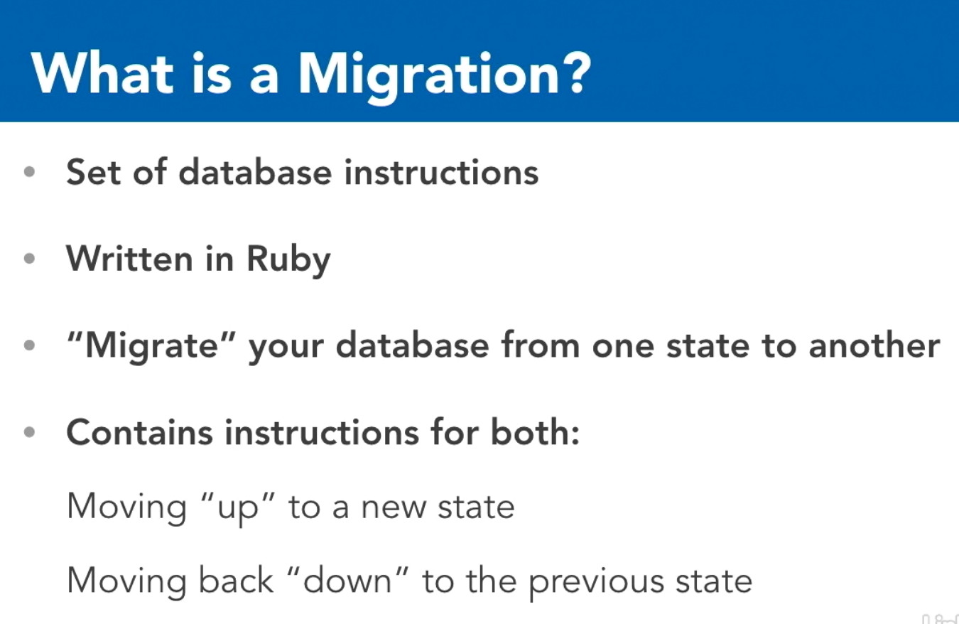
Database migrations in Ruby on Rails
Migrations are a feature of Active Record that allows you to evolve your database schema over time. ​
Rather than write schema modifications in pure SQL, migrations allow you to use an easy Ruby DSL to ​
describe changes to your tables.​

Slide 4
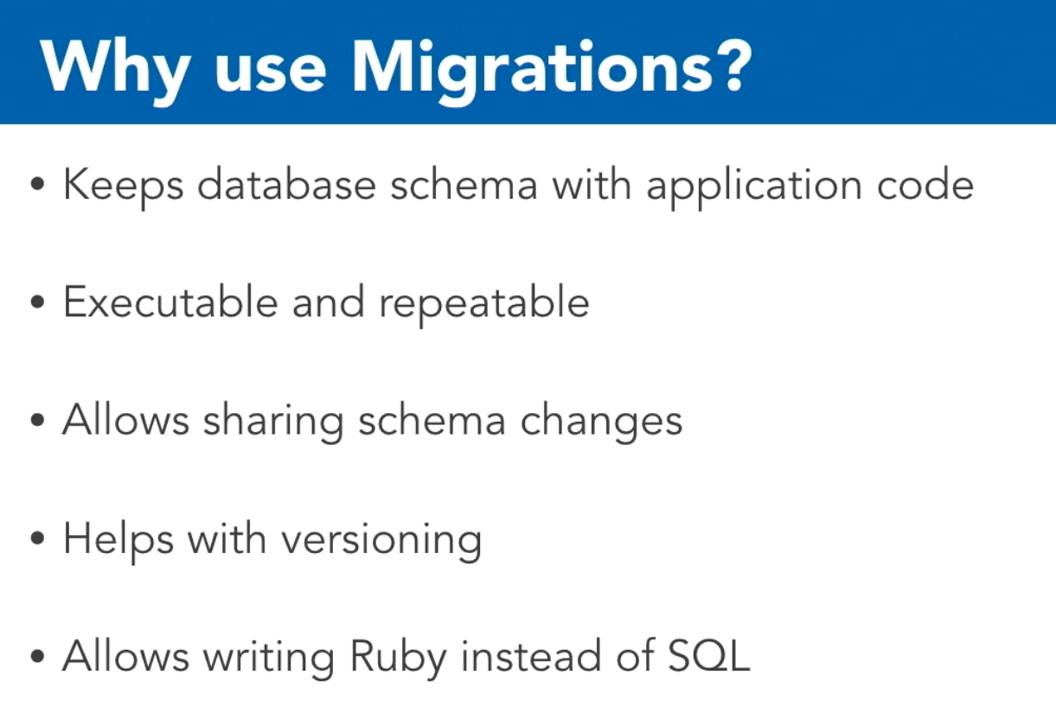
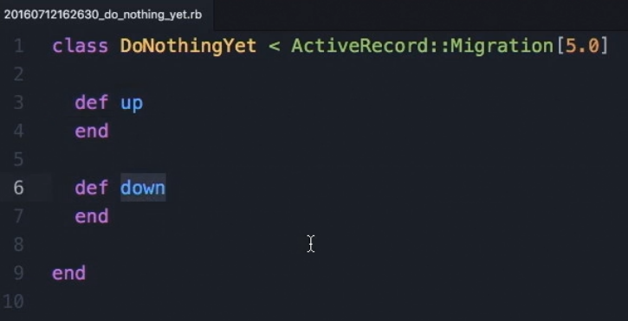
Database migrations in Ruby on Rails

Slide 5
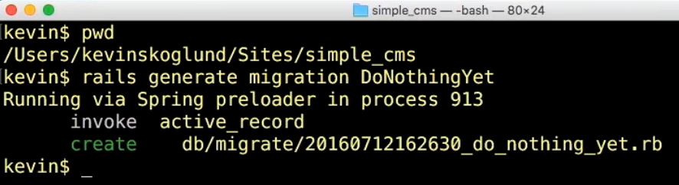
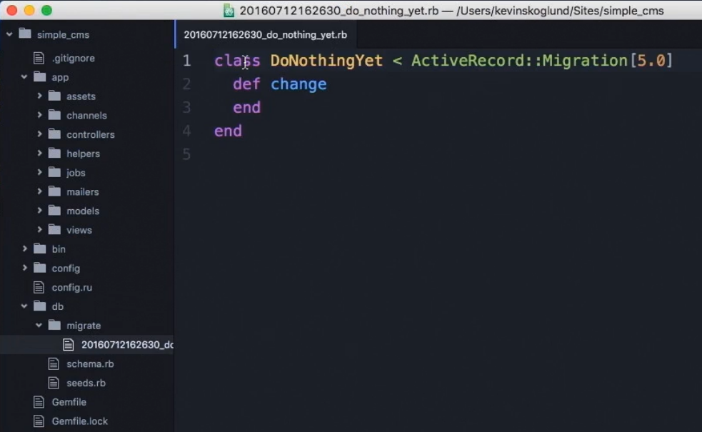
Creating migrations
To create migration files:​
rails g model Product name:string description:text
rails g scaffold Product name:string description:text
rails g migration AddShortToProducts short:text
rails g migration RemoveShortFromProducts short:text

Slide 6
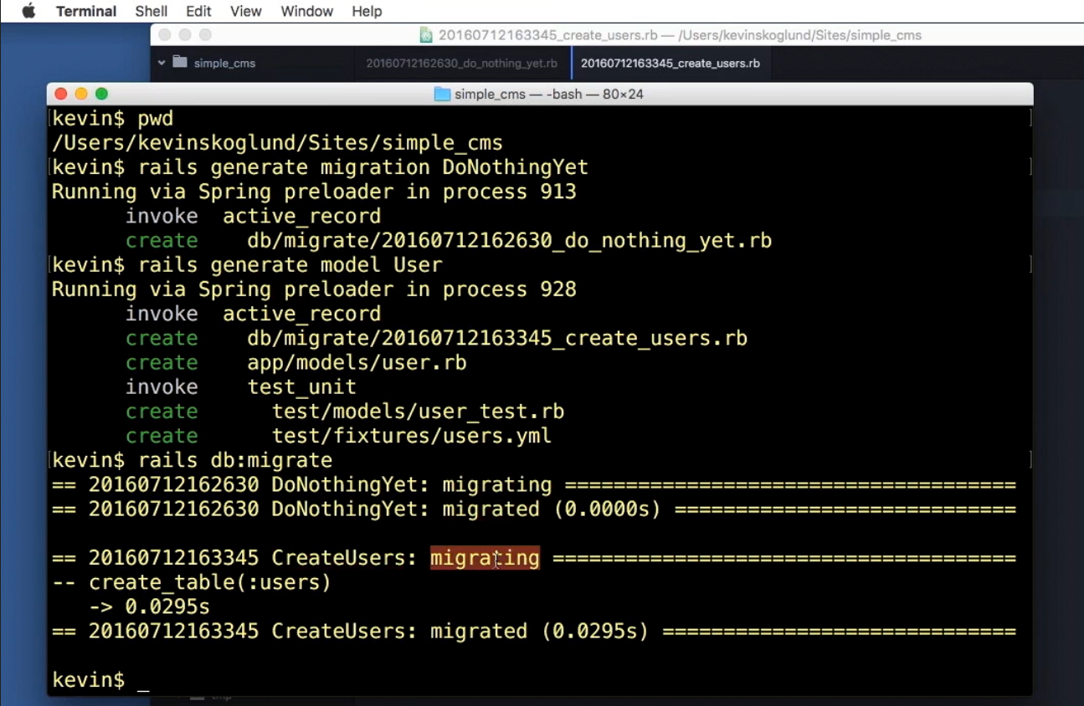
Running migrations in RoR

Slide 7
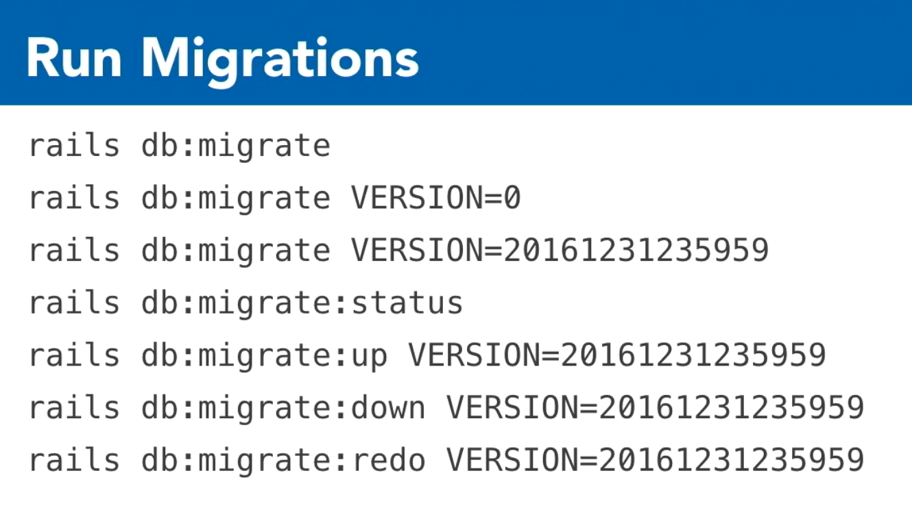
Running migrations in RoR

Slide 8
Column Types:
:integer
:primary_key
:string
:text
:time
:timestamp
:references
:binary
:boolean
:date
:datetime
:decimal
:float

Slide 9
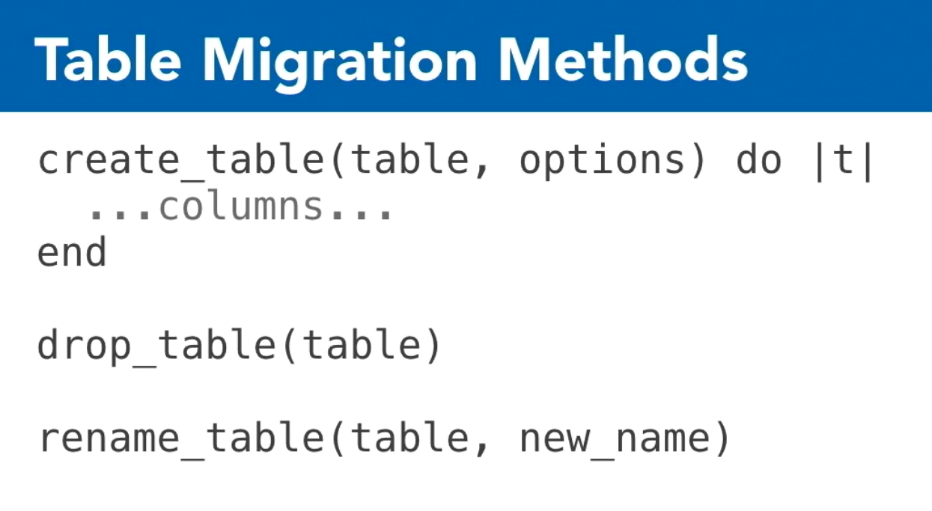
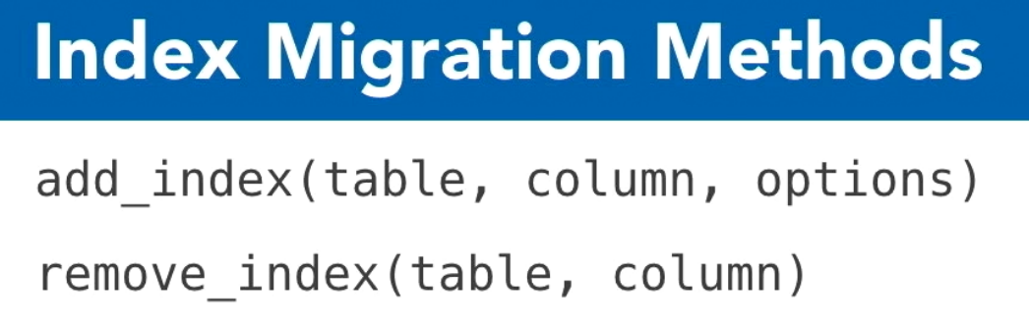
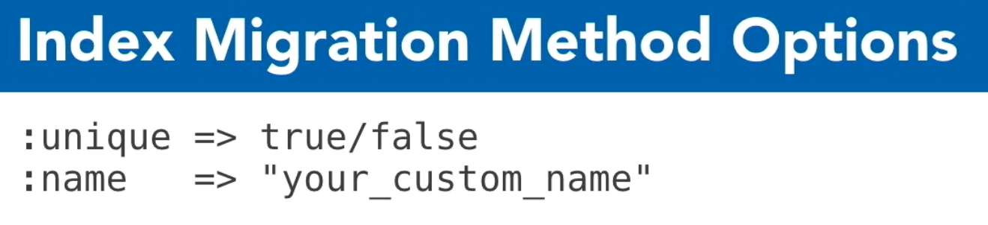
Migration methods
add_column
add_foreign_key
add_index
add_reference
add_timestamps
change_column_default
change_column_null
create_join_table
create_table
disable_extension
drop_join_table

Slide 10
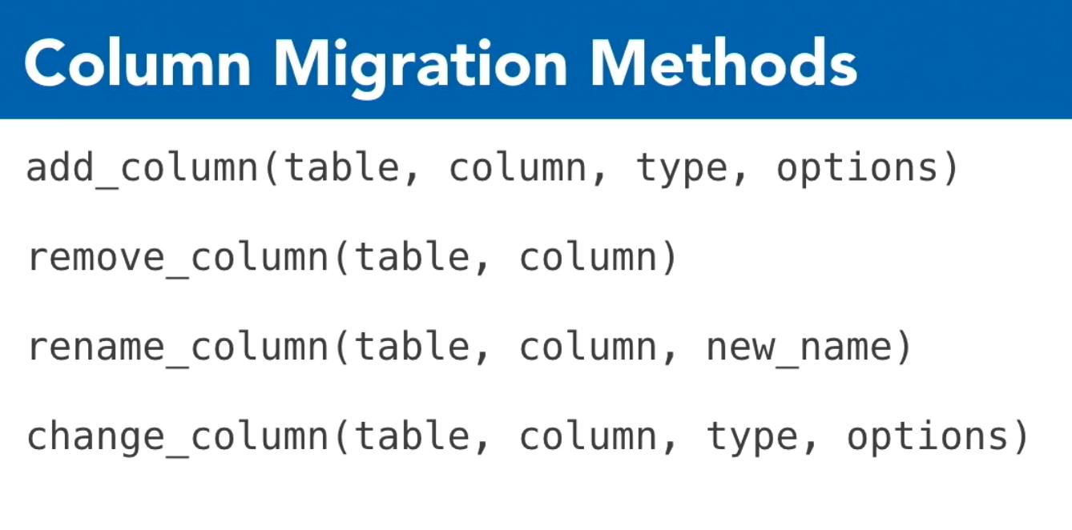
Migration methods
drop_table
enable_extension
remove_column
remove_foreign_key
remove_index
remove_reference
remove_timestamps
rename_column
rename_index
rename_table
Add and Remove Columns:
AddXXXtoYYY
RemoveXXXFromYYY
rails g migration AddShortToProducts short:text
rails g migration RemoveShortFromProducts short:text

Slide 11
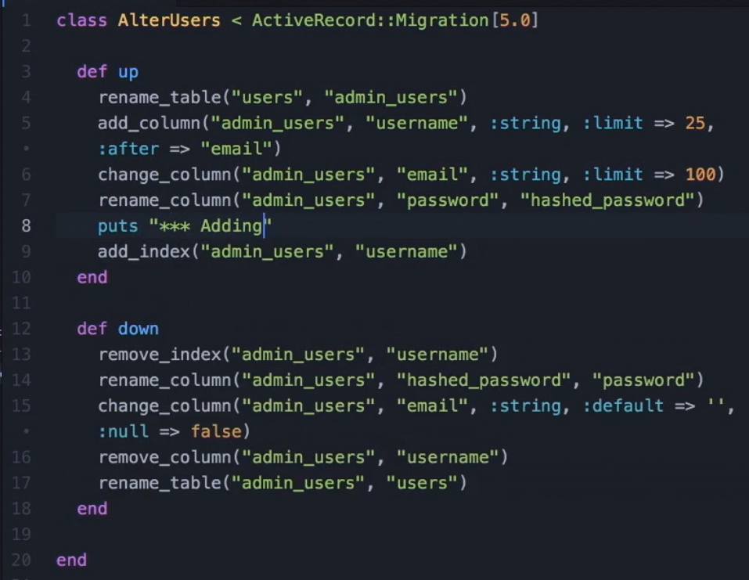
Migration methods
Init app database:
rails db:setup
db:create
db:schema:load
db:seed
rails db:reset
db:drop
db:setup

Slide 12
Best practices
“...developers should not be afraid to clear out the old migrations directory, dump a new schema, and continue on from there...”;
Never have data only migrations, or migration that change existing data;
Keep the schema.rb (or structure.sql) under version control;
Use rails db:schema:load instead of rails db:migrate to initialize an empty database;
When writing constructive migrations (adding tables or columns), use the change method instead of up and down methods;
Enforce default values in the migrations themselves instead of in the application layer;
Atomic changes;

Slide 13


